Slide 1
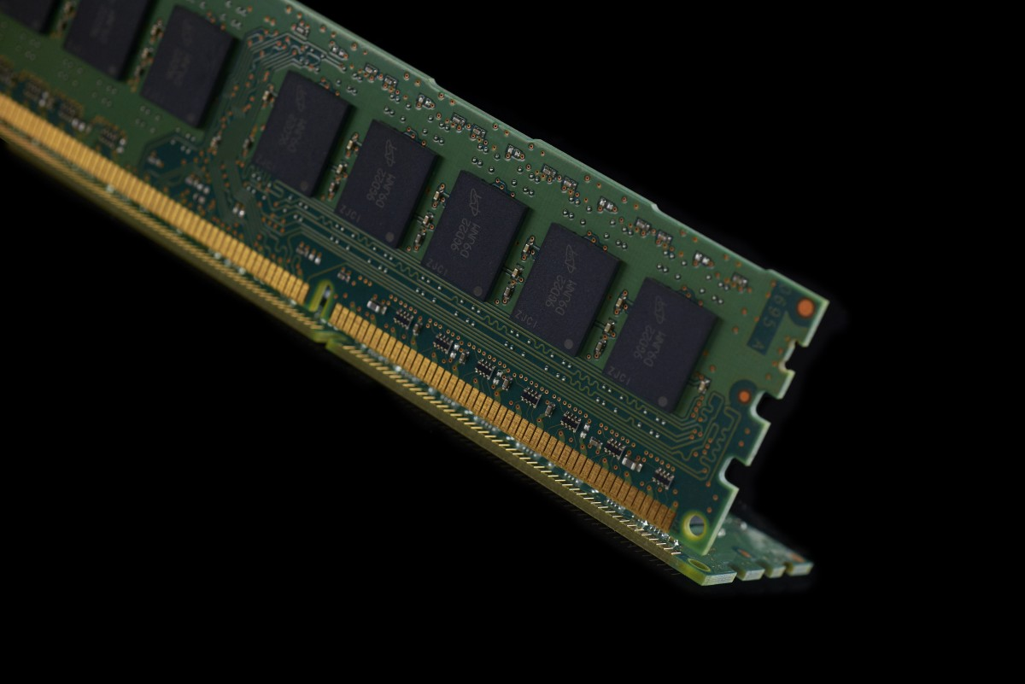
MEMORY SEGMENTS
Presented by
K.Sindhuja reddy

Slide 2

CONTENTS
Introduction
Description about every segment in memory segments
Stack
Heap
Examples to understand how the variables are segregated in the segments
References

Slide 3
INTRODUCTION
After compiling a C program, a binary executable file is created, and when we execute the program.
This binary file loads into RAM in an organized manner.
After being loaded into the RAM, memory layout in C Program has six components which are text segment, initialized data segment, uninitialized data segment, command-line arguments, stack, and heap.
Each of these six different segments stores different parts of code and have their own read, write permissions.

Slide 4
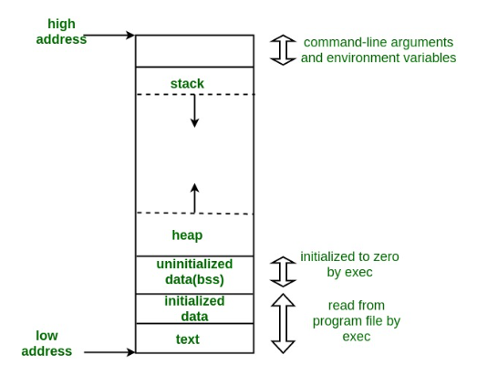
A typical memory representation of a C program consist of following segments:

Slide 5
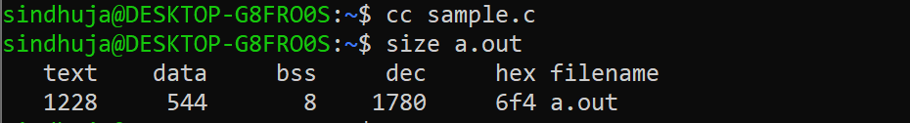
Example:(to check the default size of memory segments)
#include<stdio.h>
int main(void)
{
return 0;
}
Size (in bytes)of text, data and bss segments:

Slide 6
Symbol table
Symbol table maintains the symbols information of global variables, static variables and function names.
We cannot modify the information in this memory segment.
Static variables in the symbol table are represented in small letters.
We can see the symbols information by using objdump tool.
$objdump-t executable file.
Example:
#include<stdio.h>
int a=10; /* as a is a initialized global variable it is denoted with D*/
int b; /* as b is a uninitialized global variable it is denoted with B*/
Int main(void)
{
static int c; /* c is a uninitialized static variable it is denoted with b */
static int d=20; /* d is a initialized static variable it is denoted with d*/
return 0;
}

Slide 7
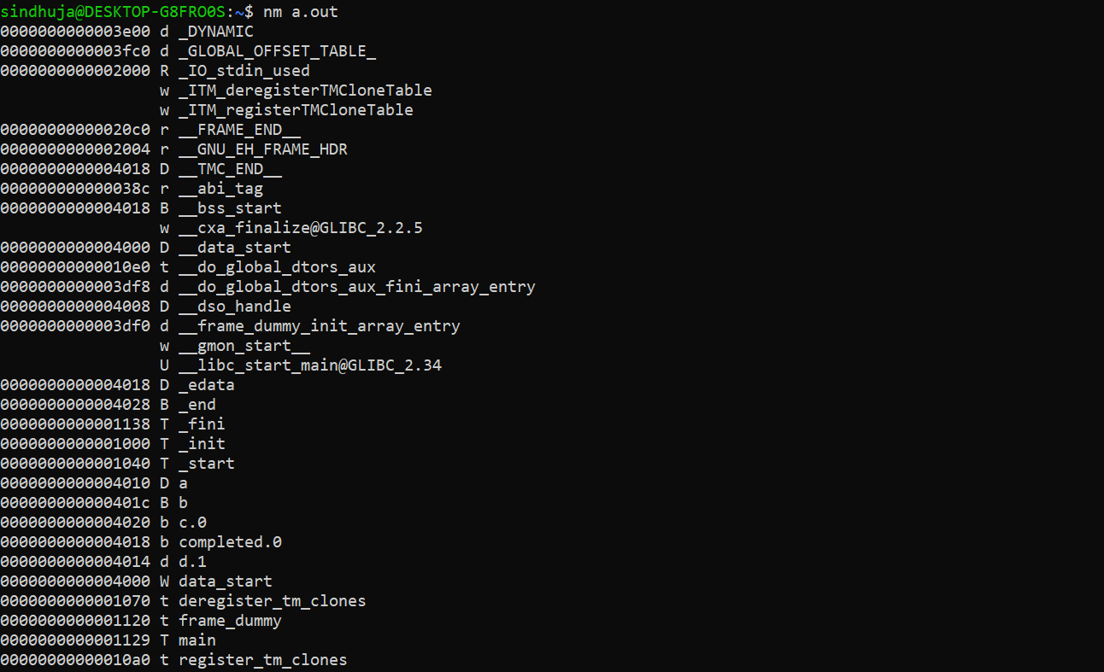
We can verify those variables by checking with nm tool:

Slide 8
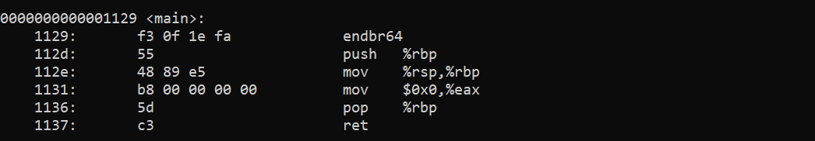
.text segment
Text segment is also know as code segment.
Text section it is a read only segment.
This segment maintains the information of function definations in machine instructions format.
Where code instruction are stored in text segment.
We cannot modify the content of the text segment during execution.
If we try to modify we get runtime errors.
We can see the content of the text segment by using objdump tool.
$ objdump -S executable filename.

Slide 9
.rodata segment
.rodata contains maintains the information about the strings which are directly passed to the function
Strings which are initialised by using pointers.
And also global variables which are applied with constant keyword.
.rodata segments is read only data segment.

Slide 10
Example :
#include<stdio.h>
char str[]=“Hello”;
int main()
{
printf(“%s\n”, str);
str[0]=‘y’;
printf(“%s\n”, str);
return 0;
}
Output : Hello
Yello
/* here we passed a string to store in an array , which is declared as globally initialized variable so it is store at data segment so we can modify the data in the data segment.*/

Slide 11
Example :
#include<stdio.h>
char *str=“Hello”;
int main()
{
printf(“%s\n”, str);
str[0]=‘y’;
printf(“%s\n”, str);
return 0;
}
Output: Hello
segmentation fault error(core dumped).
/* here we had assigned a string directly to a pointer type variable so it allocates the memory in rodata segment so we cannot modify the data, if we try to modify the data we get segmentation fault error*/

Slide 12

.data segment
.data segment contains the memory for initialised global variables and static variables.
Example(test.c):
#include<stdio.h>
Int a=10; /*initialized global variable stored in data segment*/
Int main(void)
{
static int i=20; /*initialized static variables are stored in data segment*/
return 0;
}
Here we can observe that a is global variable ‘a’ and a local variable ‘i’ applied with the static keyword are stored in .data segment.

Slide 13

.bss segment
.bss (block started by symbol).
It maintains the memory for uninitialized data like uninitialized global variables and also for the uninitialized static variables.
This segment memory gets allocated when you load the program.
Example(test.c) :
#include<stdio.h>
int a; /*uninitialized global variable stored in bss*/
int main(void)
{
static int i; /*uninitialized static variables are stored in bss*/
return 0;
}
From the above example variable ‘a’ and ‘i’ memory is allocated in .bss segment.

Slide 14
Stack
Stack stores the variables and arguments of the function.
Stack grows downwards in following scenarios:
1.When a function is invoked.
2.When we use recursive function.
3.When a new thread is created.

Slide 15
Example :
#include<stdio.h>
int add(int a, int b);
void main(void)
{
int x=10,y=20,z;
z=add(x, y);
printf(“%d\n”, z);
}
int add(int a, int b)
{
int c;
c = a + b;
return c;
}
Output: 30
/* the above variables x, y and z variables memory is allocated in stack frame of main() and the memory for a , b and c are allocated in stack frame of add().*/

Slide 16
Heap
Heap stores all dynamically allocated memory in the program.
Heap grows upwards in following scenarios:
When we use DMA calls like
malloc()
calloc()
realloc()
When we request the memory using sbrk(),brk() system calls.

Slide 17
Example :
#include<stdio.h>
#include<stdlib.h>
void main()
{
int *ptr=(int *)malloc(1 * sizeof(int));
if(ptr==NULL)
printf(“failed to allocate the memory in the heap segment\n”);
else
{
*ptr=10;
printf(“%d\n”,*ptr);
}
free(ptr);
}
Output: 10
/* as ptr memory is allocated dynamically so ptr is stored in heap segment*/

Slide 18
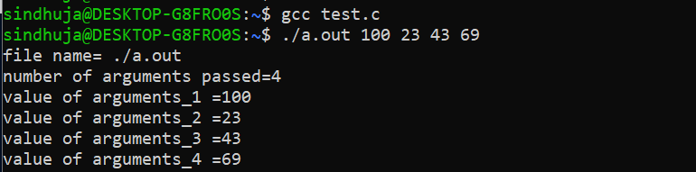
Command-line arguments
When a program executes with arguments passed from the console like argv and argc and other environment variables.
Example(test.c):
#include<stdio.h>
int main(int argc, char *argv[]){
int i;
printf(“file name =%s\n”, argv[0]);
printf(“number of arguments passed =%d\n”,argc-1);
for(i=1; i < argc; i++){
printf(“value of arguments_%d =%s\n”, I, argv[i]);
}
return 0;
} Output:

Slide 19
References
The Linux Programming Interface -by Michael kerrisk.
https://www.geeksforgeeks.org/memory-layout-of-c-program/
https://www.scaler.com/topics/c/memory-layout-in-c/

Slide 20
ANY QUESTIONS

Slide 21
THANK YOU

